Slide 1
CI/CD
CONTINUOUS INTEGRATION / CONTINUOUS DELIVERY

Slide 2
Team members
رحمة إبراهيم
مؤتمن كمال الدين
مهند وحيد
أبوبكر معتصم

Slide 3
Background
competition between the companies in :-
Fast release of software
Quality software
Think in :-
New automated development approach
Agile methodology

Slide 4
Motivation
Software Engineering related field
Contribution to the software industry
Learning
To acquire the bachelor degree

Slide 5
Search problem
Integration of different modules
Time waste in doing unproductive processes
Deploying software that might have not been tested
finding bugs at late stage

Slide 6
Importance and effect
Target audiences :-
IT companies, and Development teams
Importance :-
Quick release of software
Quality assurance
Building valuable software

Slide 7
Scope
Build automation, and test automation
GitHub as VCS
Test report
Continuous Delivery
Supports Java language
JUnit

Slide 8
Baseline requirement
GitHub API
Hosting Server
Container

Slide 9
Objectives
Automated test run
Early detecting bug
grantee each piece of code has been checked
Testing in same production environment

Slide 10
Expected outcome
Reliable software release
Increase productivity
Grantee that software will act same in production environment

Slide 11
Literature review
Title | Methodology | Problem type | Solutions | result
Continuous Delivery : Overcoming adoption challenges | In company “Paddy Power” | organizational | Strategy | 6 strategies
Problems , causes and solutions when adopting continuous delivery | 293 articles , 30 selected | More technical , relationship | Technical solution | 40 problem , 28 relation ,29 solution

Slide 12
Literature review
Jenkins
Travis CI

Slide 13
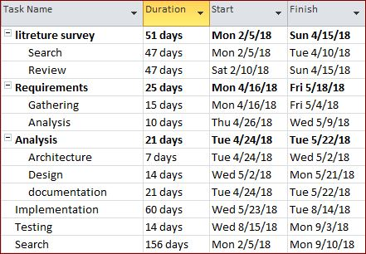
Time schedule

Slide 14
Information source
SemiCode .inc
Lemon Taxi
Nile center
Jenkins documentation
Travls documentation
Papers

Slide 15
Field
Software
DveOps
Web development

